Slide 1
AiCore – Data Scraping Project
By – Simeon Bamgbaye
August 2021
Contents
Introduction
Scope of Study
Method
Data Analysis / Prediction
Challenges
Next Steps

Slide 2
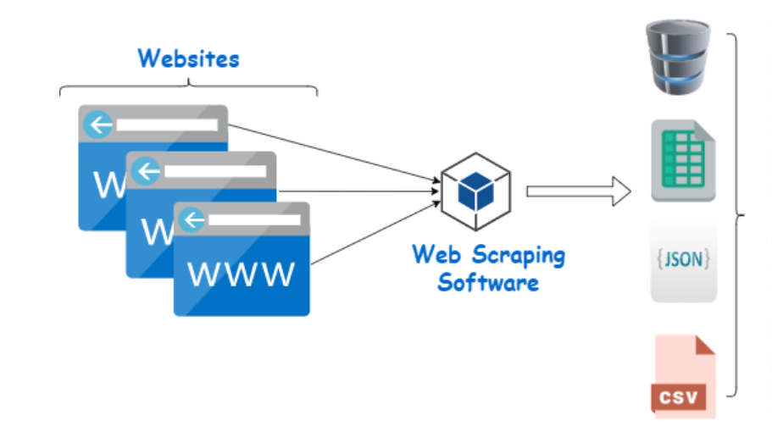
Introduction
Scope of Study
The objective of the project was using web scraping tools to collect data from the internet that will have an industrial purpose
Set scope of study was to get comfortable working with Python Classes, packages, modules implementing OOP and working with Cloud services.
Fig. 01: Web Scraping

Slide 3
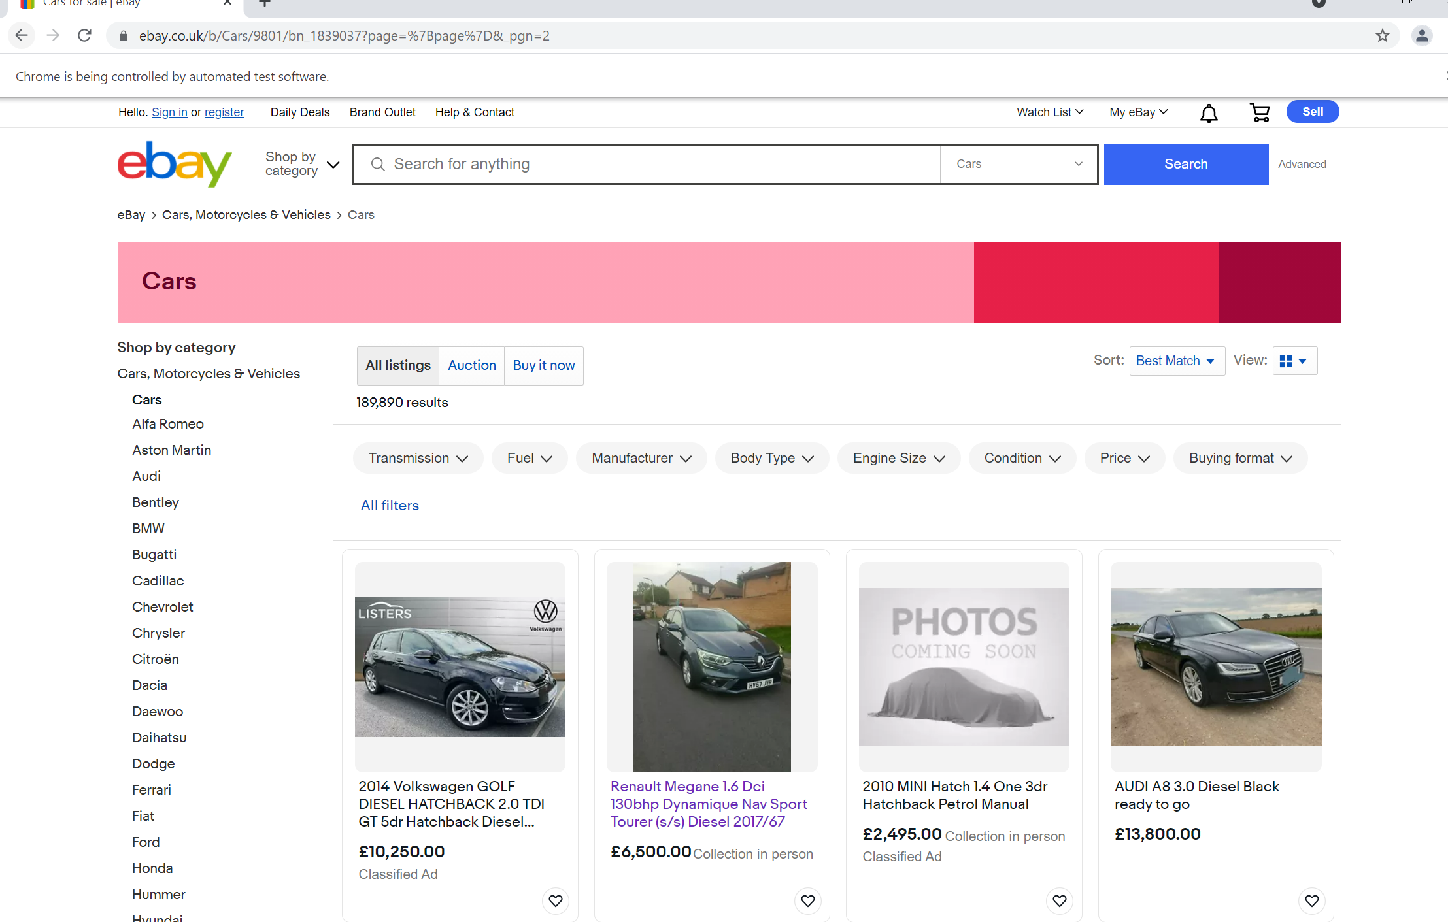
Method
Fig. 02: Layout of ebay Car section

Slide 4
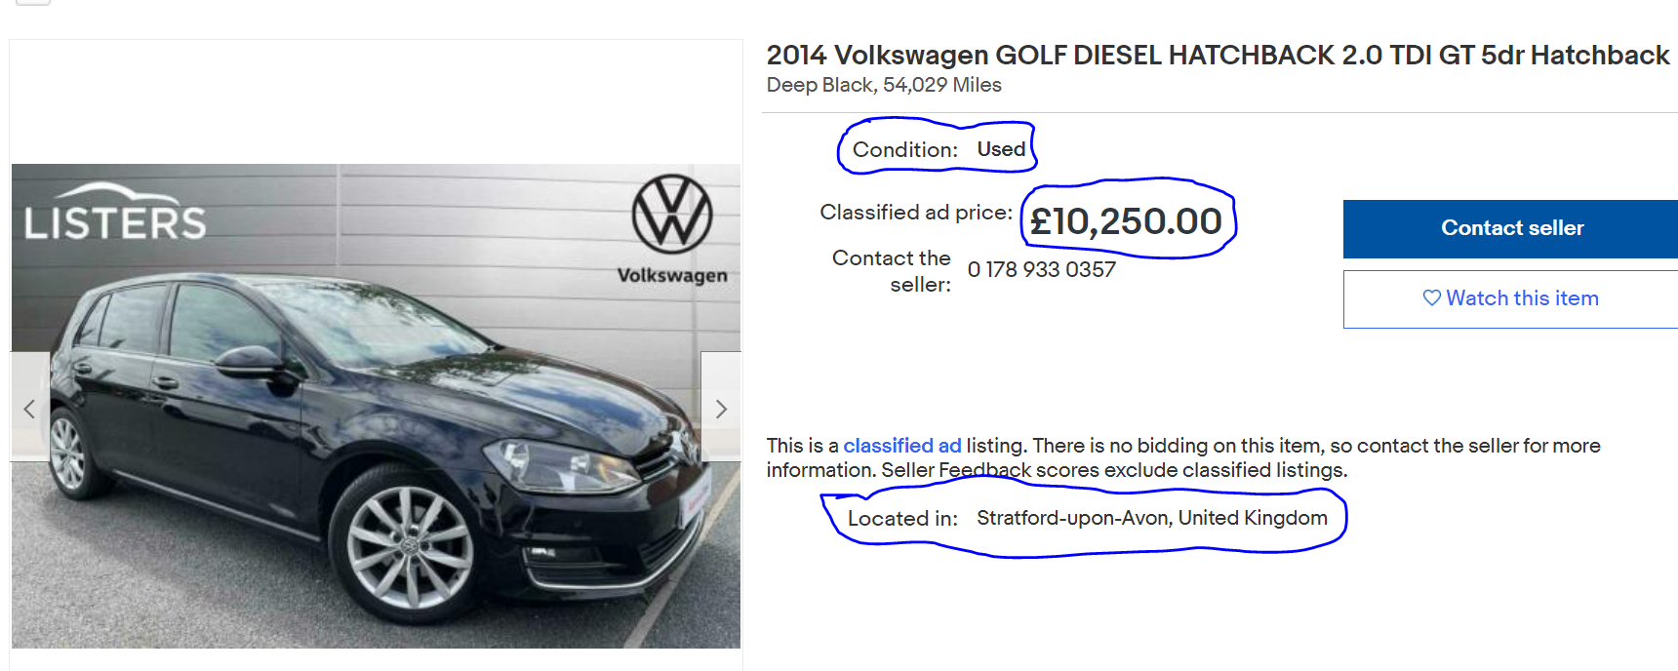
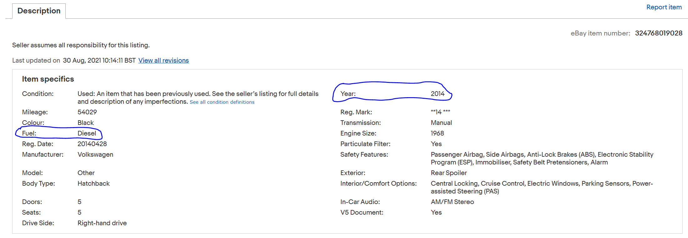
Method
Fig. 03: Scraped data from ebay
Fig. 03a: Scraped data from ebay

Slide 5
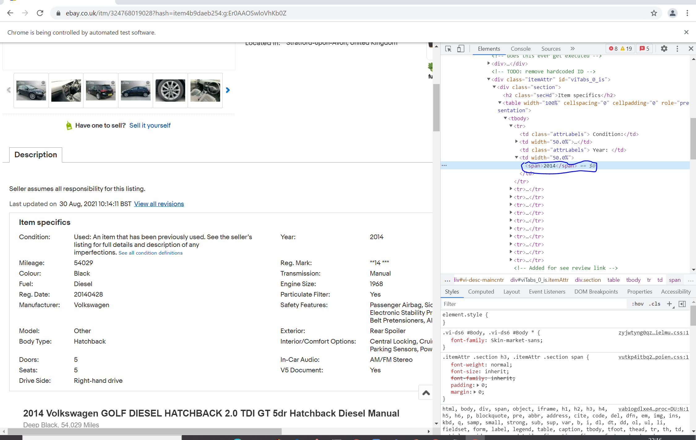
Method
Fig. 03b: Scraped data from ebay

Slide 6
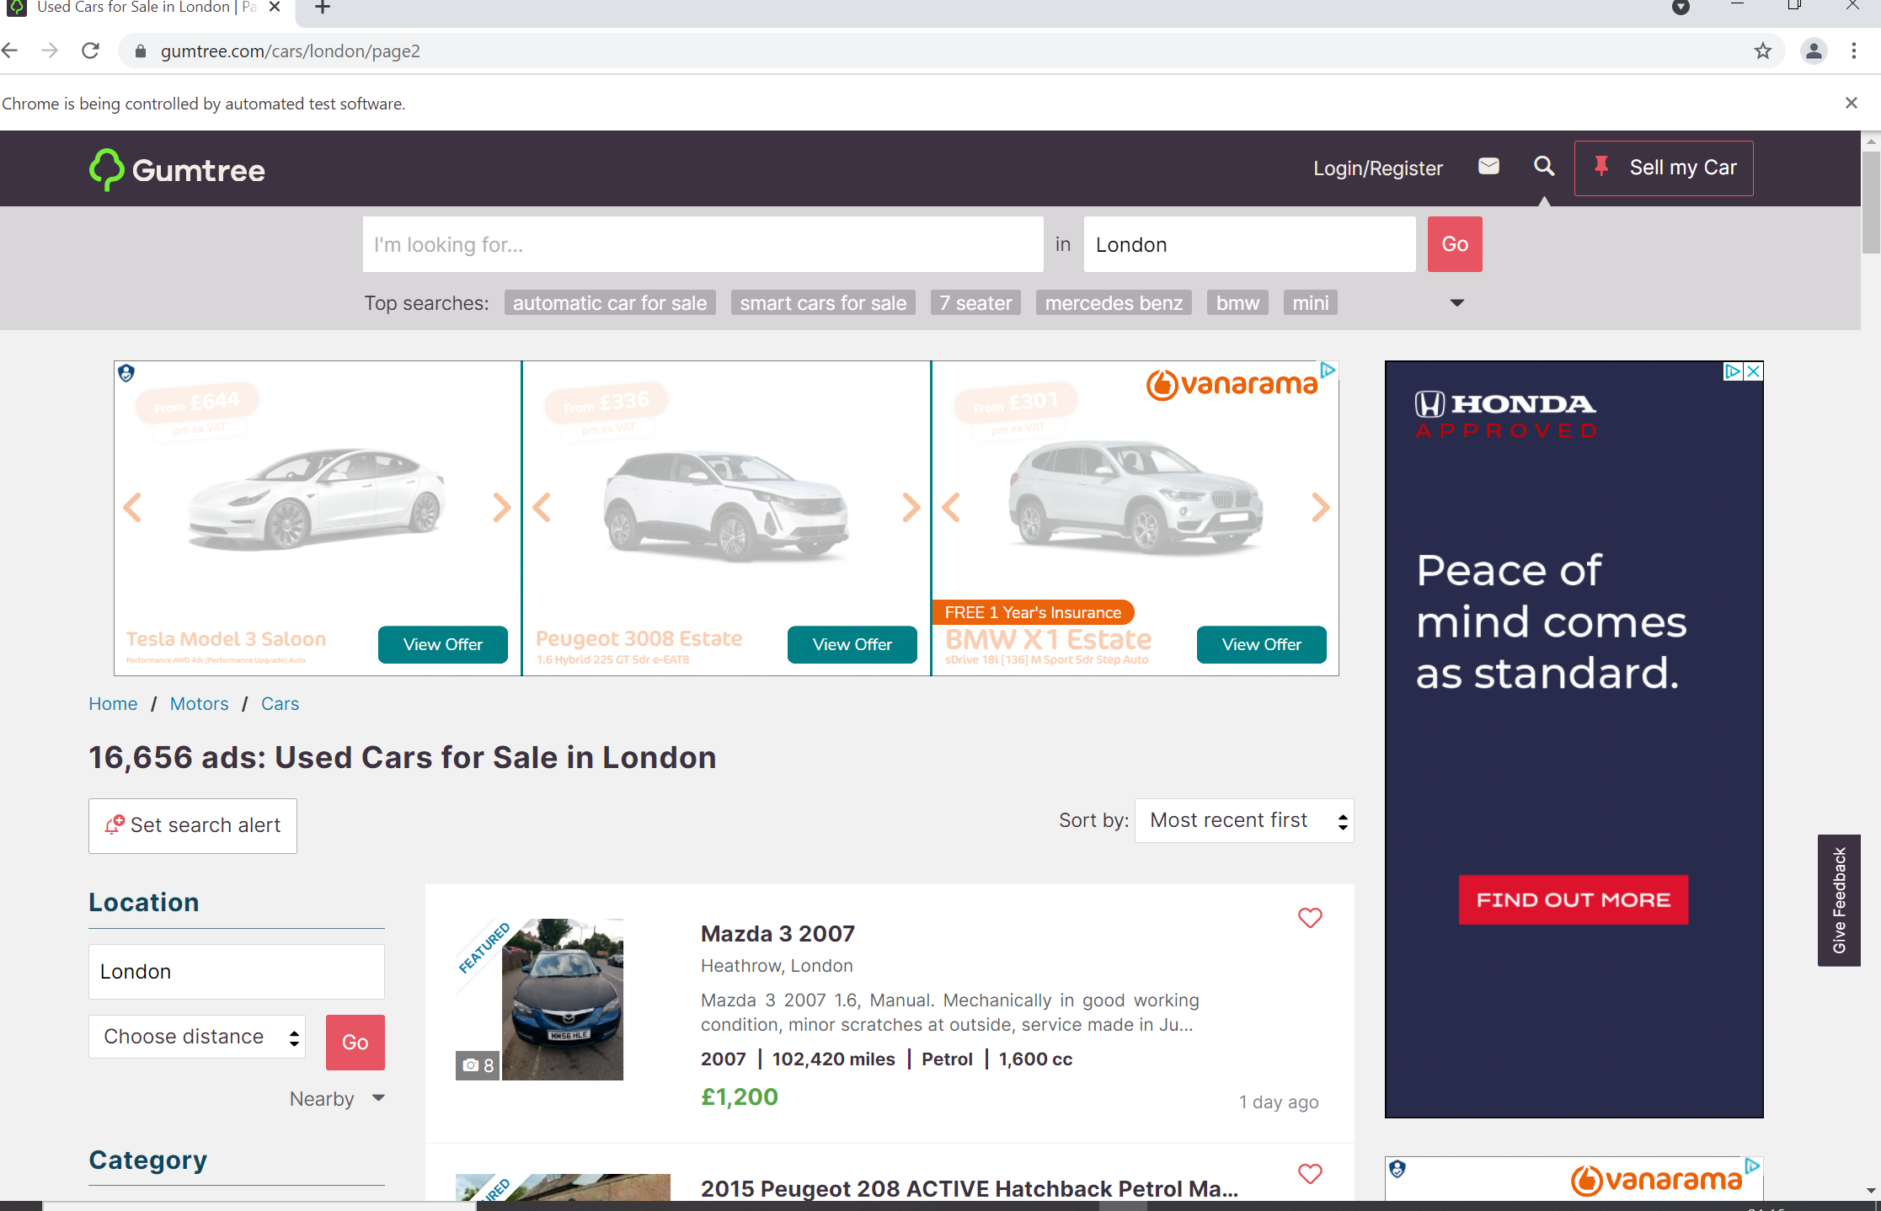
Method
Fig. 04: Layout of Gumtree Car section

Slide 7
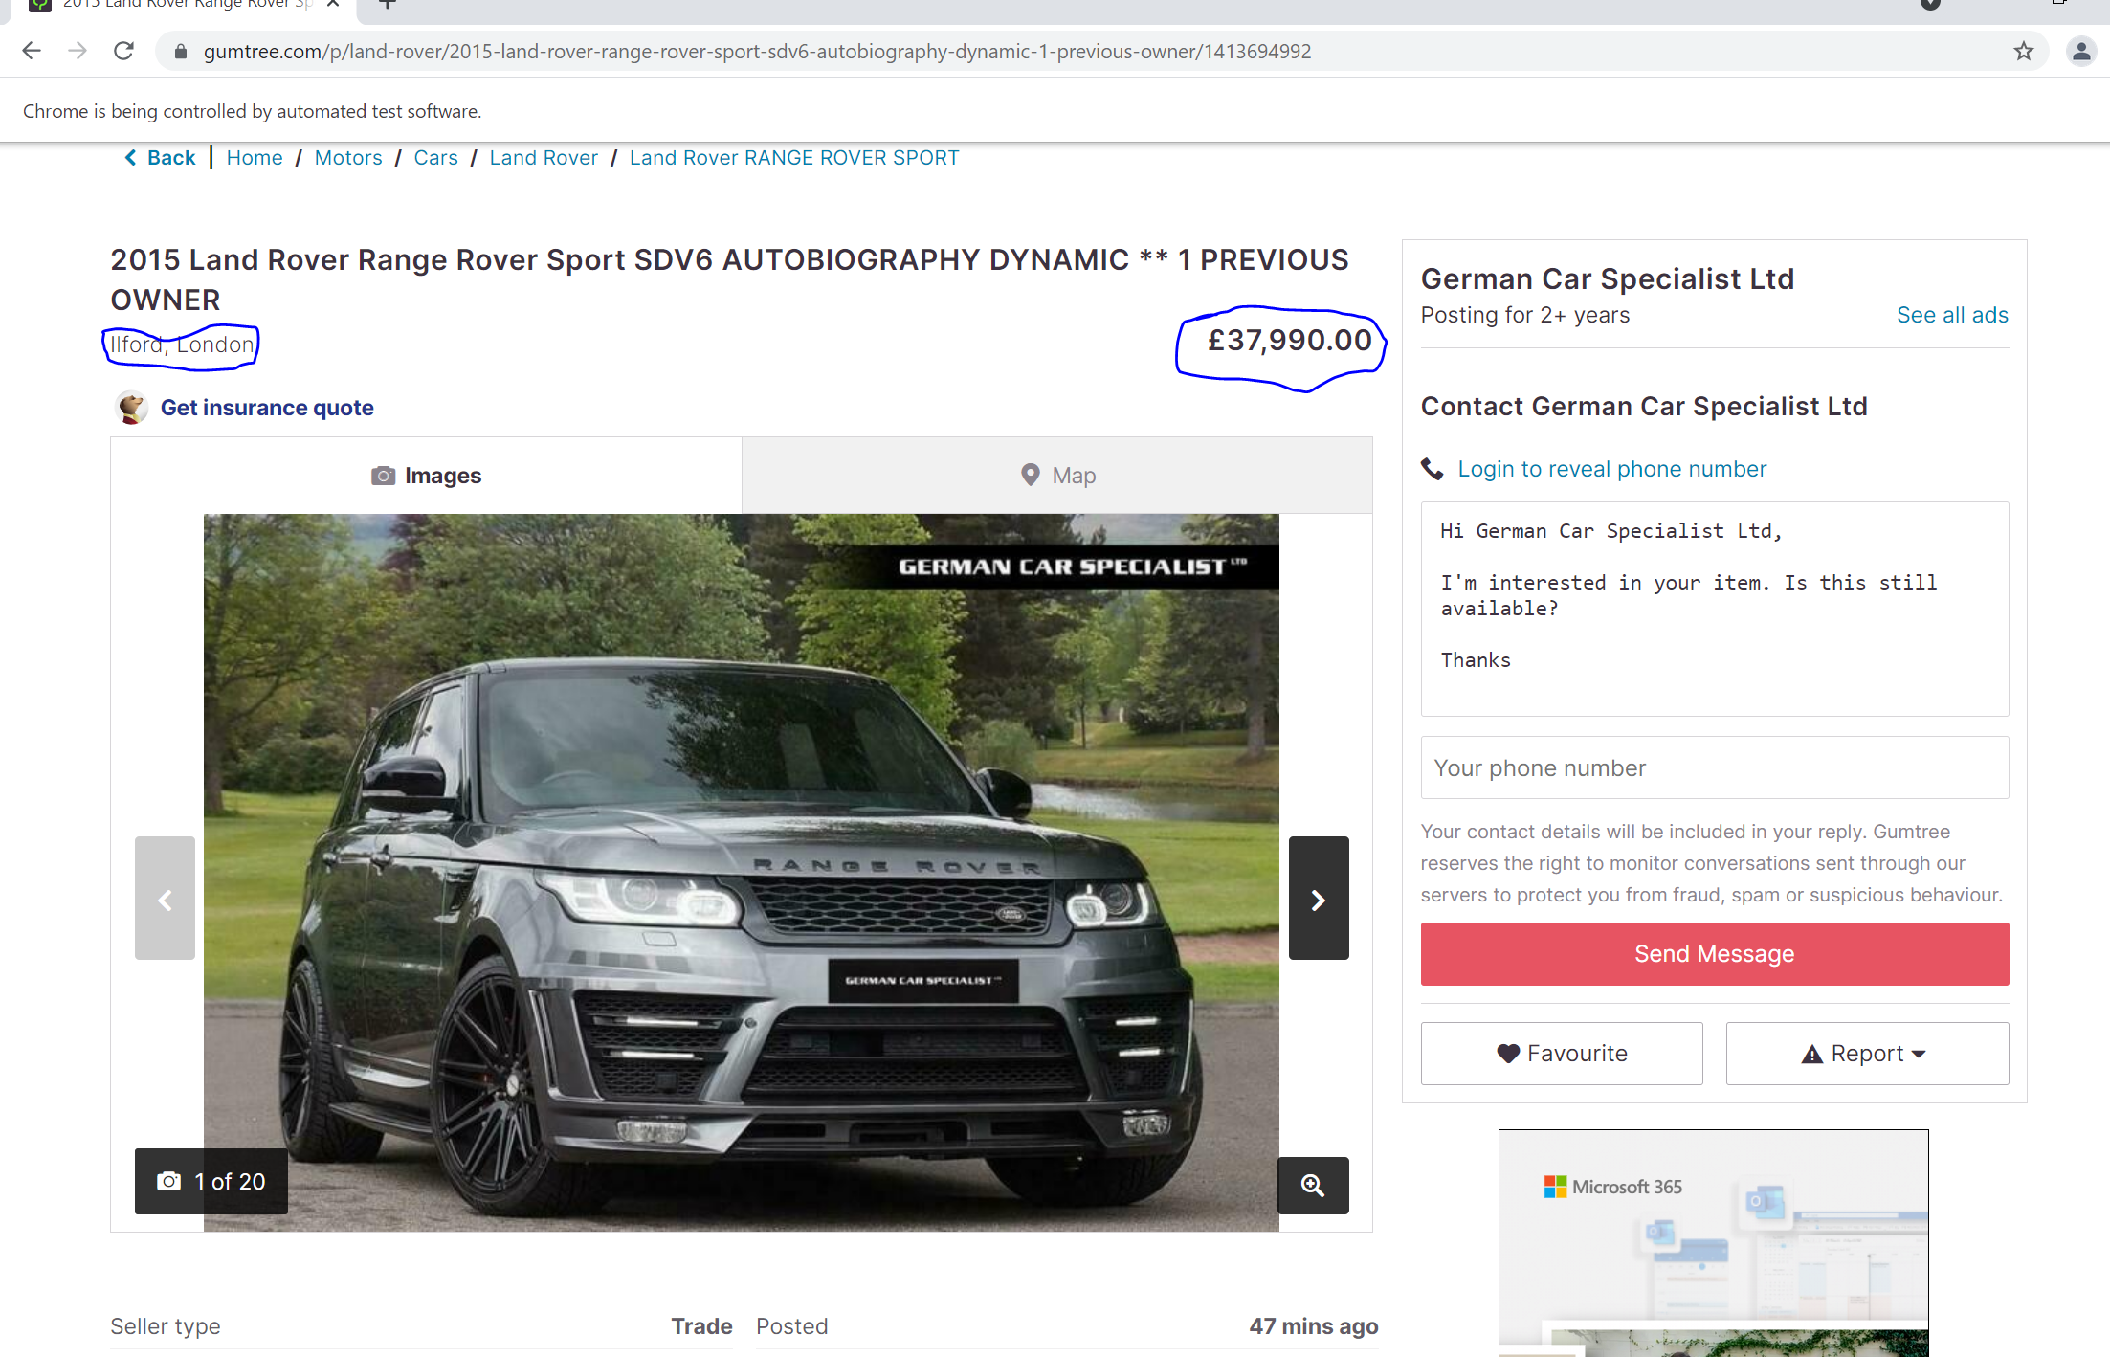
Method
Fig. 05: Scraped Price and Location data from Gumtree

Slide 8
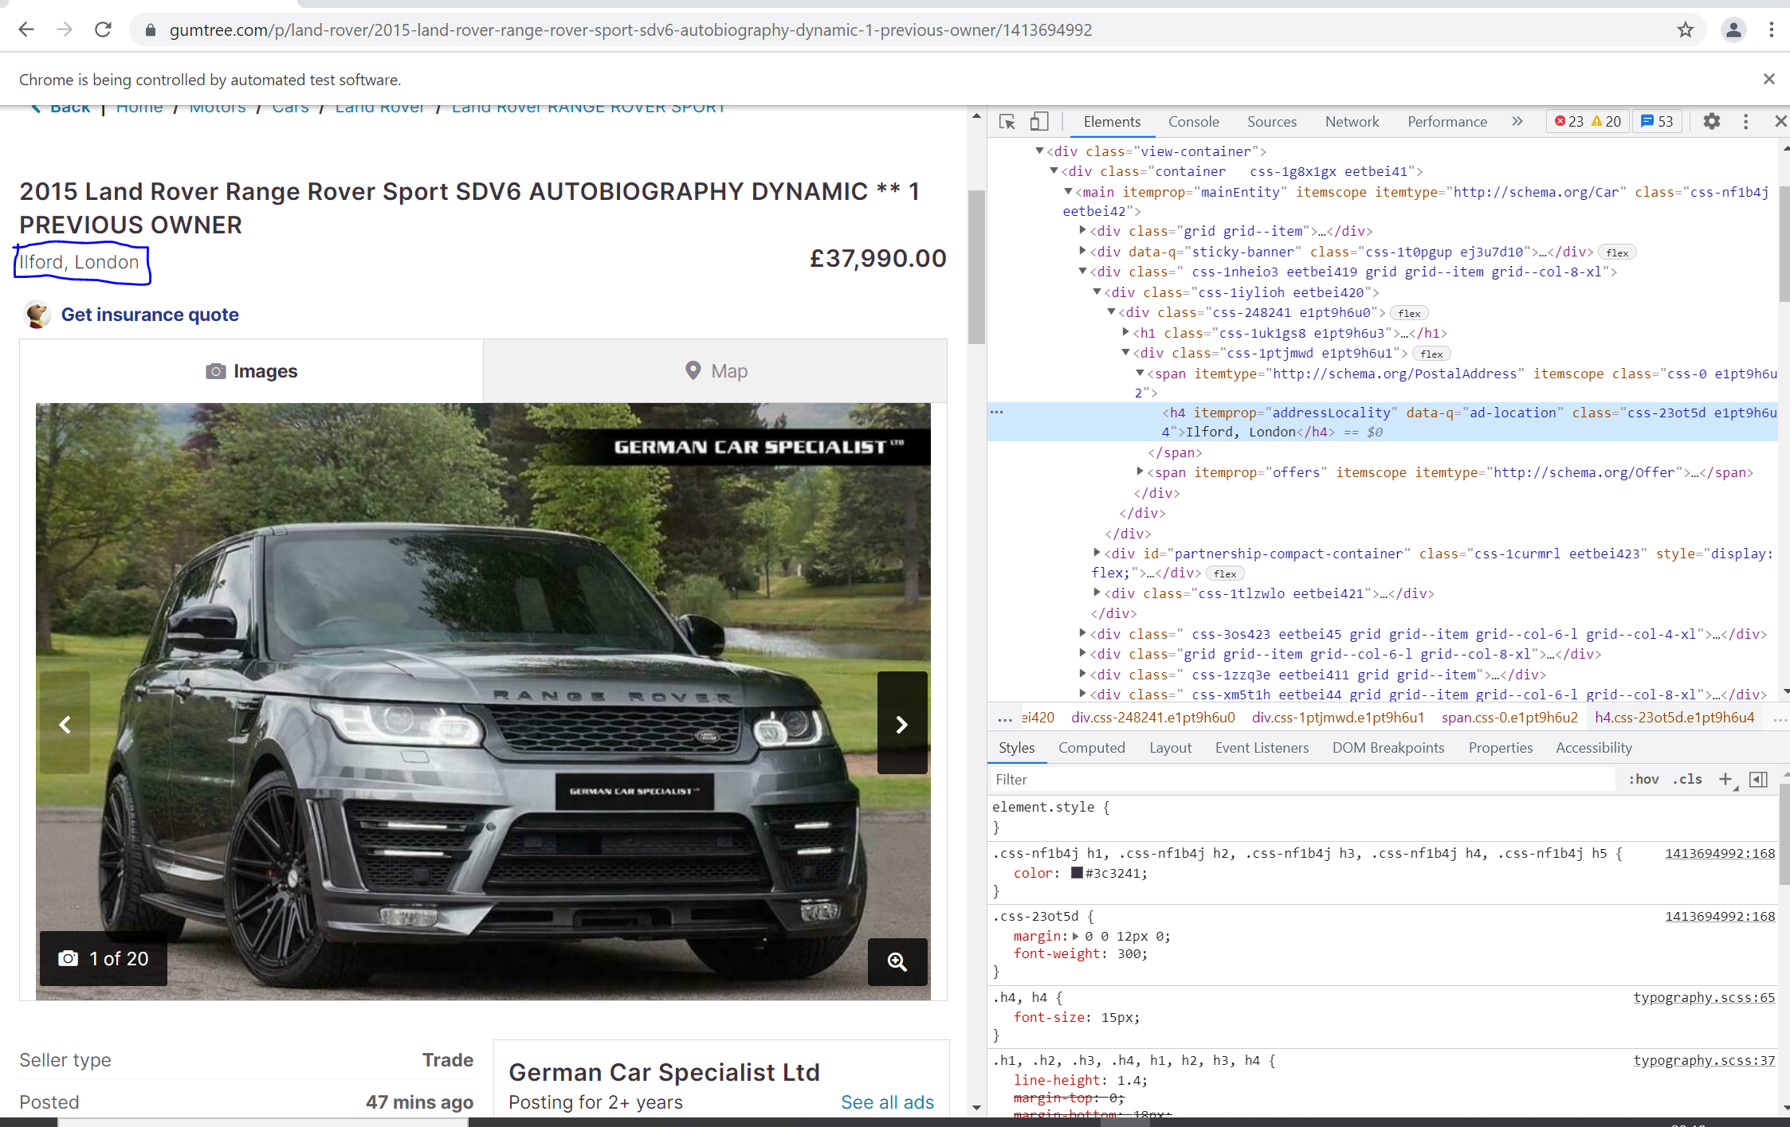
Method
Fig. 05a: Xpath reference for the Car location

Slide 9
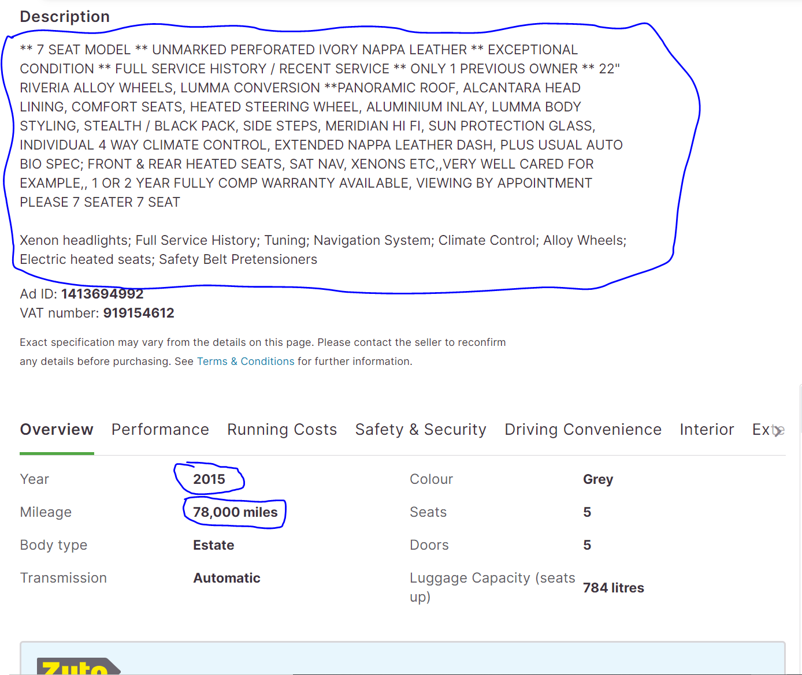
Method
Fig. 5b: Scraped Description, Year & Mileage Data from Gumtree

Slide 10
Results
Scraped data was saved into a json file, loaded into a pandas DataFrame and finally uploaded into an SQL Database.

Slide 11
Data Analysis / Prediction
Scraped data was saved into a json file and the loaded into a pandas DataFrame and then loaded into an SQL Database.
The scraped data can be analysed to gain an insight into price ranges of cars across different manufacturers.
The scraped data can be analysed to gain an insight into price ranges of cars across the country.
Ultimately, use the data to predict prices of cars across based on manufacturer or mileage

Slide 12
Challenges
Debugging errors in the code
Researching and improvising on template code solutions that to fix errors in the code
Obtaining the right Xpath

Slide 13
Next Step
Fix code successfully to allow scraping of data from multiple webpages
Condense code
Upload data to cloud / remote server

Slide 14
End
Thank You!
Any questions?

